Slide 1
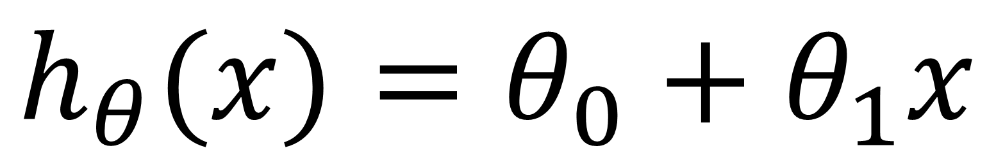
$$h_{θ}(x)=θ_{0}+θ_{1}x$$
model parameters
features
samples

Slide 2
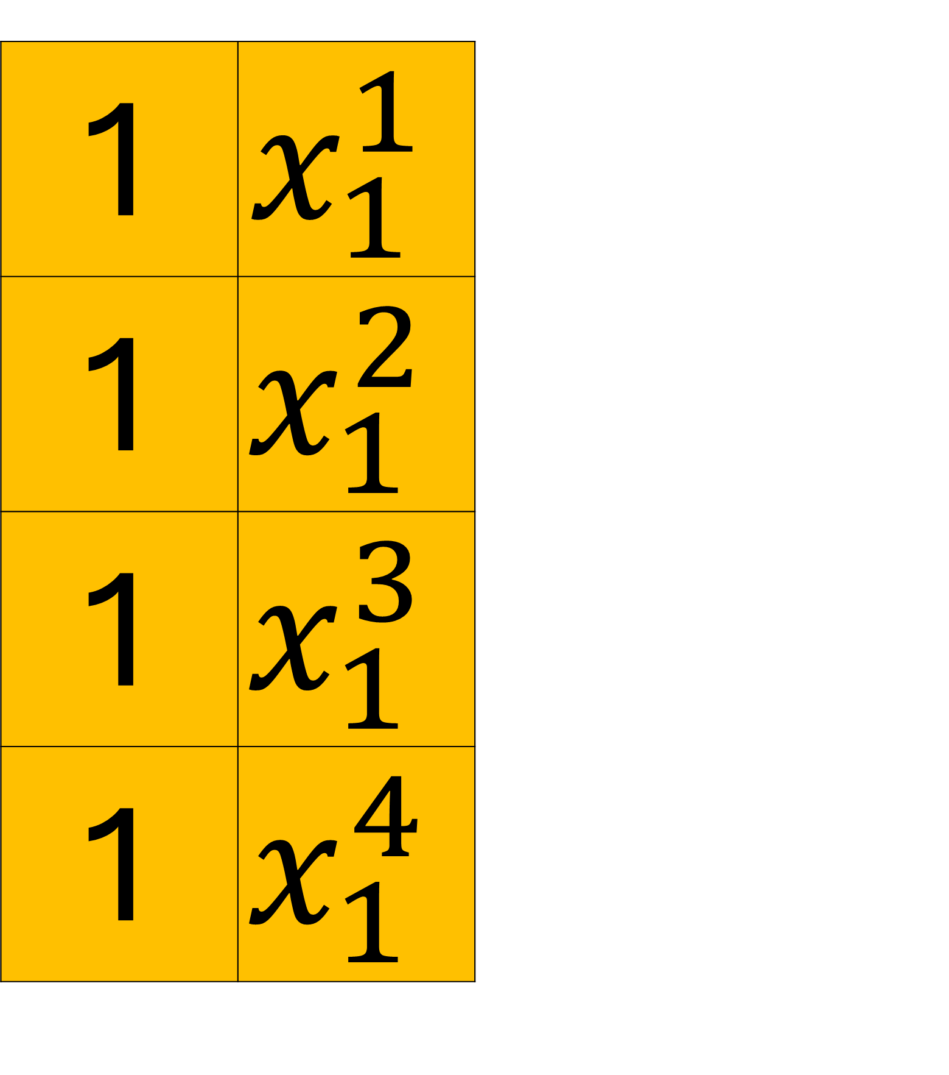
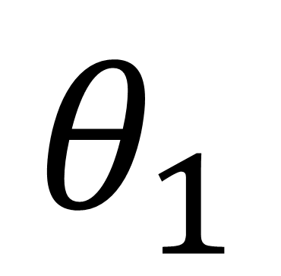
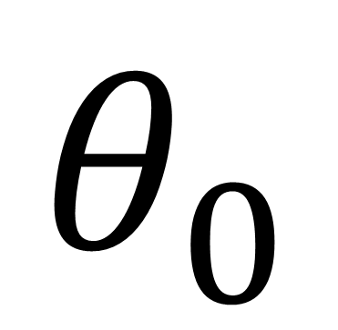
$$h_{θ}(x)=θ_{0}+θ_{1}x$$
model parameters
features
$$θ_{0}$$
$$θ_{1}$$
1 | $$x_{1}^{1}$$
1 | $$x_{1}^{2}$$
1 | $$x_{1}^{3}$$
1 | $$x_{1}^{4}$$
samples

Slide 3
$$h_{θ}(x)=θ_{0}+θ_{1}x$$
model parameters
features
$$θ_{0}$$
$$θ_{1}$$
1 | $$x_{1}^{1}$$
1 | $$x_{1}^{2}$$
1 | $$x_{1}^{3}$$
1 | $$x_{1}^{4}$$
FIRST sample’s
First feature
SECOND sample’s
samples
First feature
THIRD sample’s
First feature
FOURTH sample’s
First feature

Slide 4
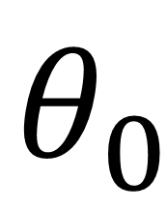
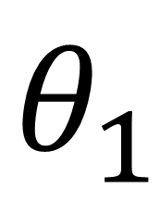
$$h_{θ}(x)=θ_{0}+θ_{1}x$$
model parameters
$$θ_{0}$$
$$θ_{1}$$
features
450 | 0.15
1 | 2104
1 | 1416
1 | 1534
1 | 852
samples

Slide 5
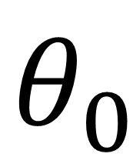
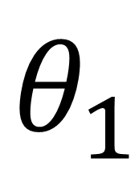


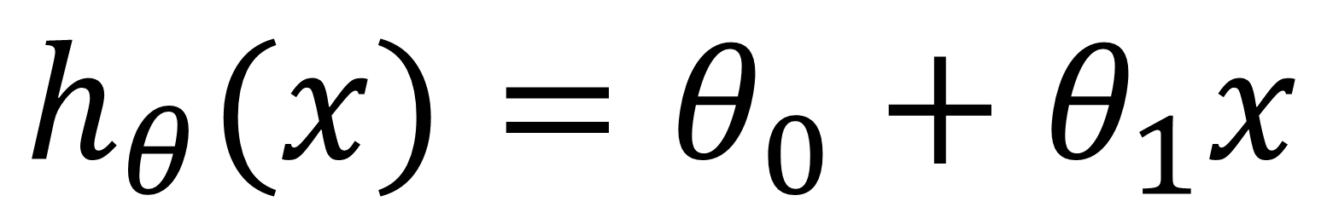
$$h_{θ}(x)=θ_{0}+θ_{1}x$$
$$θ_{0}$$
$$θ_{1}$$
450 | 0.15
$$×$$
$$×$$
1 | 2104
1 | 1416
1 | 1534
1 | 852

Slide 6

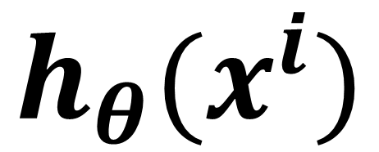
$$h_{θ}(x)=θ_{0}+θ_{1}x$$
$$θ_{0}$$
$$θ_{1}$$
450 | 0.15
Predicted
value
$$×$$
$$×$$
$$h_{θ}(x^{i})$$
1 | 2104
1 | 1416
1 | 1534
1 | 852
$$+$$
766

Slide 7
$$h_{θ}(x)=θ_{0}+θ_{1}x$$
$$θ_{0}$$
$$θ_{1}$$
450 | 0.15
Predicted
value
$$×$$
$$×$$
$$h_{θ}(x^{i})$$
1 | 2104
1 | 1416
1 | 1534
1 | 852
766

Slide 8
$$h_{θ}(x)=θ_{0}+θ_{1}x$$
$$θ_{0}$$
$$θ_{1}$$
450 | 0.15
Predicted
value
$$×$$
$$×$$
$$h_{θ}(x^{i})$$
1 | 2104
1 | 1416
1 | 1534
1 | 852
766
662
$$+$$

Slide 9
$$h_{θ}(x)=θ_{0}+θ_{1}x$$
$$θ_{0}$$
$$θ_{1}$$
450 | 0.15
Predicted
value
$$×$$
$$×$$
$$h_{θ}(x^{i})$$
1 | 2104
1 | 1416
1 | 1534
1 | 852
766
662

Slide 10

$$h_{θ}(x)=θ_{0}+θ_{1}x$$
$$θ_{0}$$
$$θ_{1}$$
450 | 0.15
Predicted
value
$$×$$
$$×$$
$$h_{θ}(x^{i})$$
1 | 2104
1 | 1416
1 | 1534
1 | 852
766
662
680
$$+$$

Slide 11
$$h_{θ}(x)=θ_{0}+θ_{1}x$$
$$θ_{0}$$
$$θ_{1}$$
450 | 0.15
Predicted
value
$$×$$
$$×$$
$$h_{θ}(x^{i})$$
1 | 2104
1 | 1416
1 | 1534
1 | 852
766
662
680

Slide 12

$$h_{θ}(x)=θ_{0}+θ_{1}x$$
$$θ_{0}$$
$$θ_{1}$$
450 | 0.15
Predicted
value
$$×$$
$$×$$
$$h_{θ}(x^{i})$$
1 | 2104
1 | 1416
1 | 1534
1 | 852
766
662
680
578
$$+$$

Slide 13
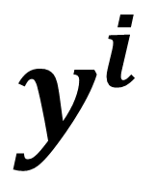
$$h_{θ}(x)=θ_{0}+θ_{1}x$$
$$θ_{0}$$
$$θ_{1}$$
450 | 0.15
Predicted
value
Actual
value
$$h_{θ}(x^{i})$$
$$y^{i}$$
1 | 2104
1 | 1416
1 | 1534
1 | 852
766
662
680
578
400
232
315
178

Slide 14
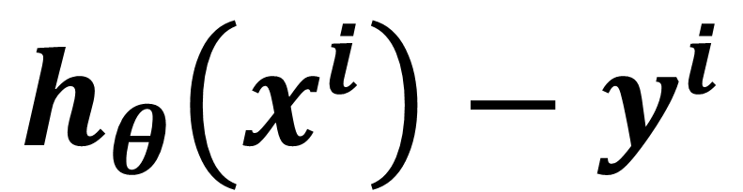
$$h_{θ}(x)=θ_{0}+θ_{1}x$$
$$θ_{0}$$
$$θ_{1}$$
450 | 0.15
Predicted
value
Actual
value
$$h_{θ}(x^{i})$$
$$y^{i}$$
$${h_{θ}\left(x^{i}\right)−y}^{i}$$
1 | 2104
1 | 1416
1 | 1534
1 | 852
766
662
680
578
400
232
315
178
366
430
365
400

Slide 15
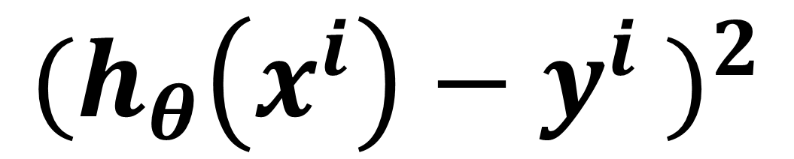
$$h_{θ}(x)=θ_{0}+θ_{1}x$$
$$θ_{0}$$
$$θ_{1}$$
450 | 0.15
Predicted
value
Actual
value
$$h_{θ}(x^{i})$$
$$y^{i}$$
$${h_{θ}\left(x^{i}\right)−y}^{i}$$
$${({h_{θ}\left(x^{i}\right)−y}^{i} )}^{2}$$
1 | 2104
1 | 1416
1 | 1534
1 | 852
766
662
680
578
400
232
315
178
366
430
365
400
133956
184900
133225
160000

Slide 16
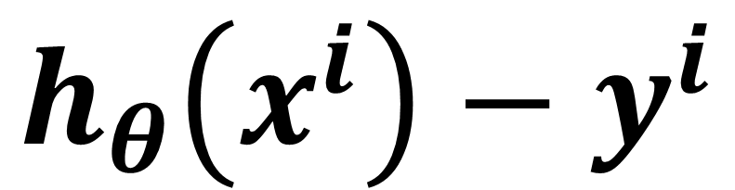
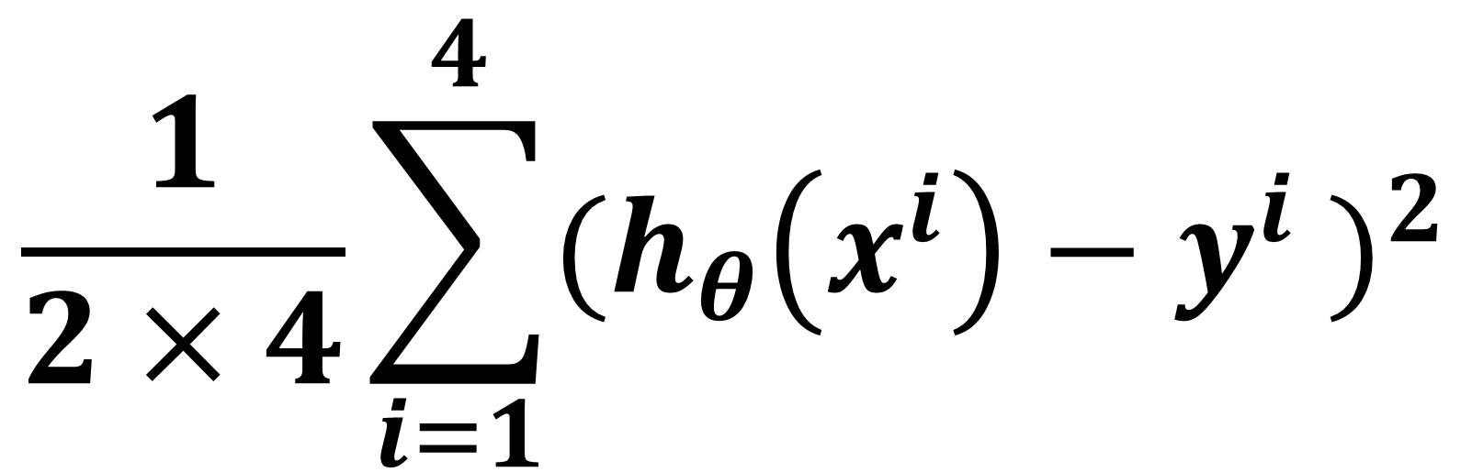
$$h_{θ}(x)=θ_{0}+θ_{1}x$$
$$θ_{0}$$
$$θ_{1}$$
450 | 0.15
Predicted
value
Actual
value
$$\frac{1}{2×4}\sum_{i=1}^{4}{{({h_{θ}\left(x^{i}\right)−y}^{i} )}^{2}}$$
$$h_{θ}(x^{i})$$
$$y^{i}$$
$${h_{θ}\left(x^{i}\right)−y}^{i}$$
$${({h_{θ}\left(x^{i}\right)−y}^{i} )}^{2}$$
1 | 2104
1 | 1416
1 | 1534
1 | 852
766
662
680
578
400
232
315
178
366
430
365
400
133956
184900
133225
160000
76,510

Slide 17
$$h_{θ}(x)=θ_{0}+θ_{1}x$$
$$θ_{0}$$
$$θ_{1}$$
450 | 0.15
Predicted
value
Actual
value
Mean Squared Error
$$\frac{1}{2×4}\sum_{i=1}^{4}{{({h_{θ}\left(x^{i}\right)−y}^{i} )}^{2}}$$
$$h_{θ}(x^{i})$$
$$y^{i}$$
$${h_{θ}\left(x^{i}\right)−y}^{i}$$
$${({h_{θ}\left(x^{i}\right)−y}^{i} )}^{2}$$
1 | 2104
1 | 1416
1 | 1534
1 | 852
766
662
680
578
400
232
315
178
366
430
365
400
133956
184900
133225
160000
76,510

